Slide 1
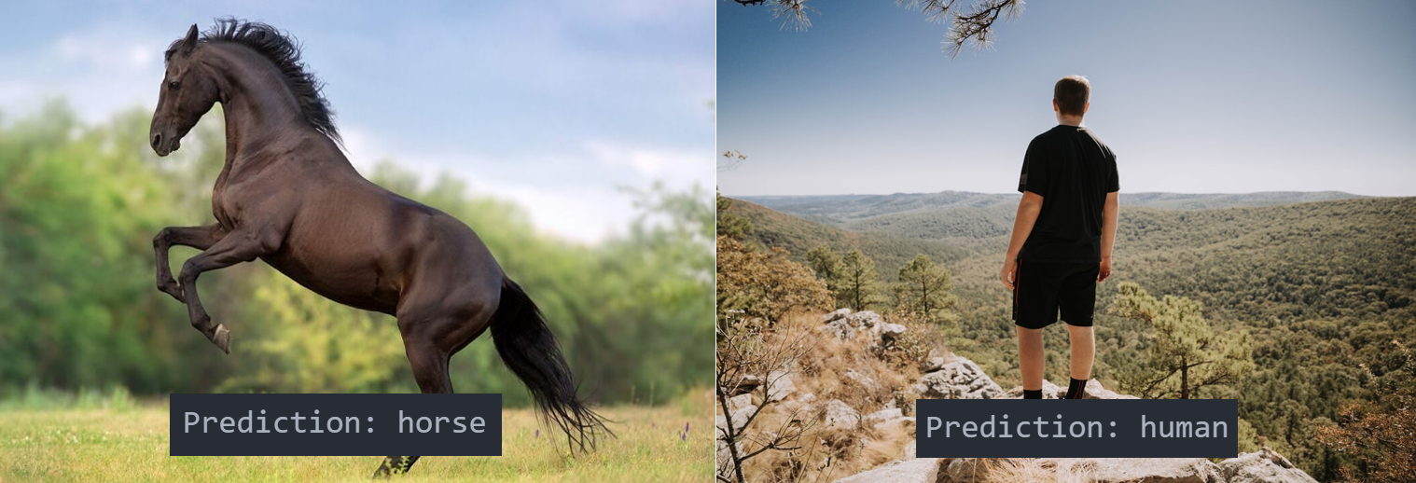
Horses or Humans
Computer Vision Project

Slide 2
AGENDA
Tech Stack
Pipelines
Hyperparameter Tuning
Frontend

Slide 3

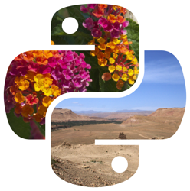


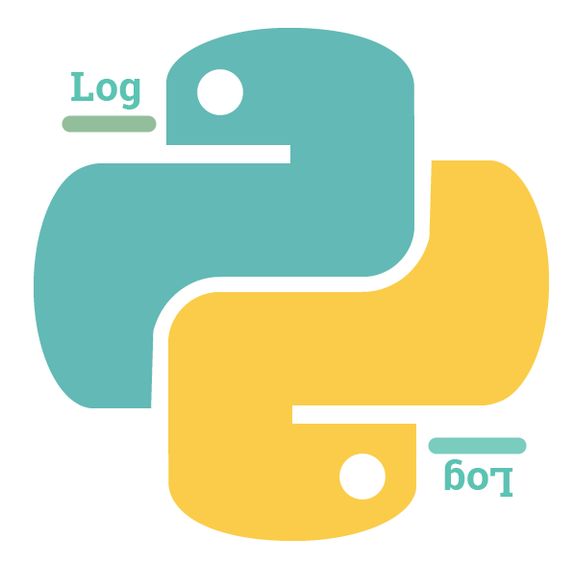




Tech Stack

Slide 4
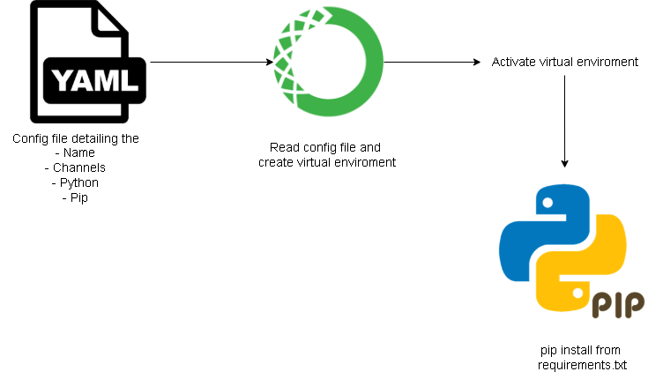
Virtual Environment

Slide 5
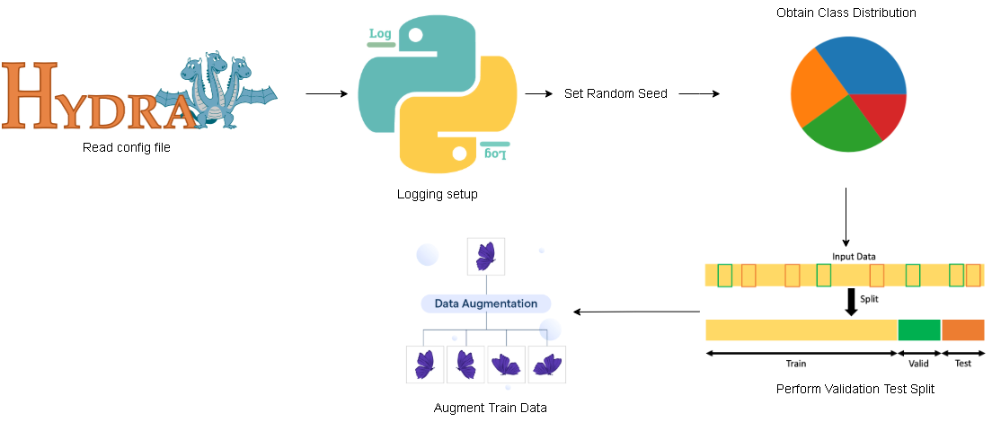
Data Preprocessing

Slide 6
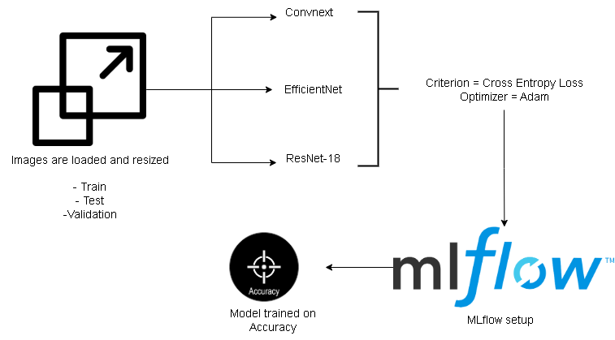
Training

Slide 7
Hyperparameter Tuning
Optuna
Accuracy
Train best model based on the selected best parameters
Name | Description | Values for Experimentation | Default Value
learning_rate | Learning rate | 0.0001, 0.001, 0.01 | 0.001
batch_size | Number of samples per training step | 16, 32 | 32
optimizer_name | Optimization algorithm | adam, sgd, adamw | adam
Bold indicate default parameters

Slide 8
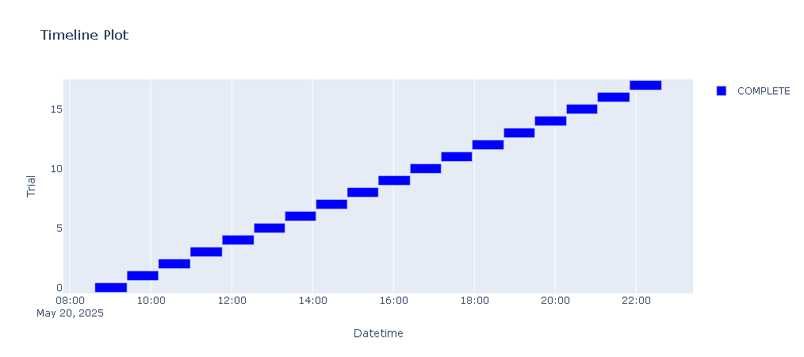

Slide 9
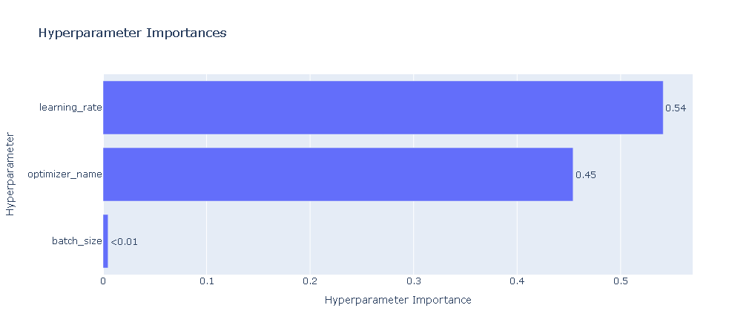

Slide 10
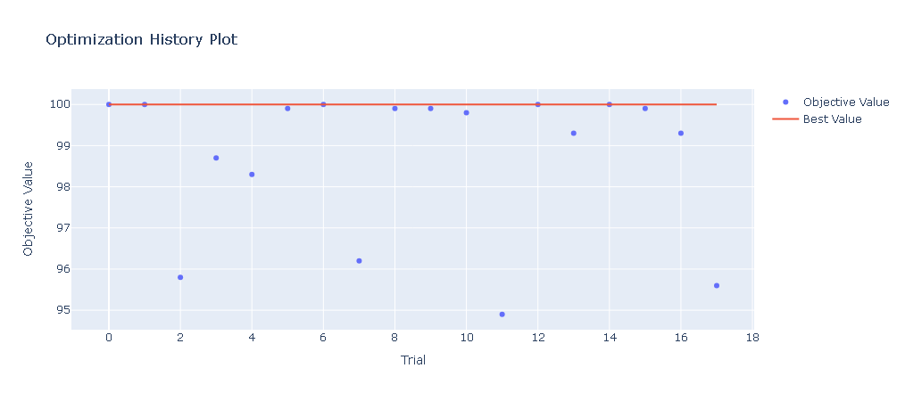

Slide 11
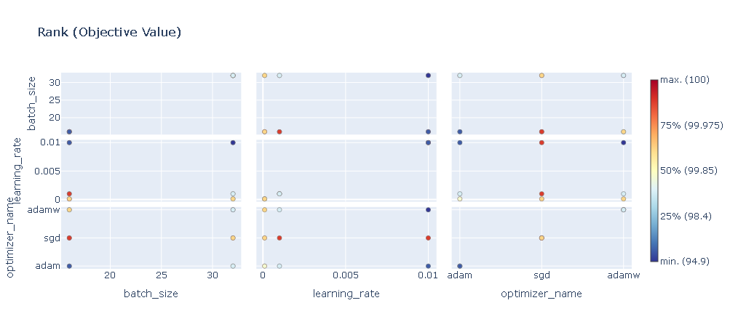

Slide 12
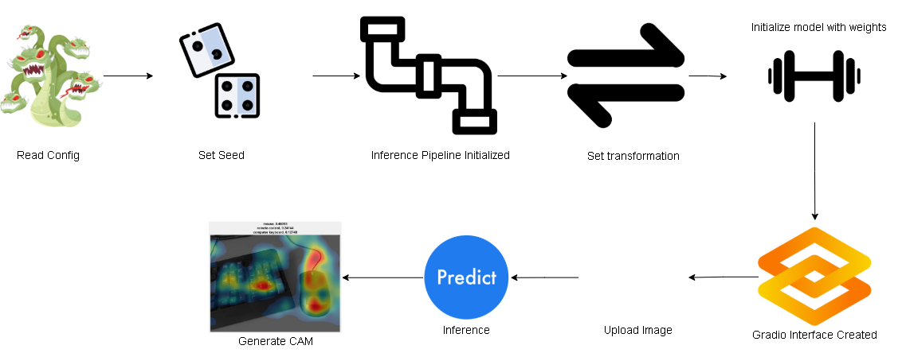
Frontend

Slide 13
Gradio App

Slide 14
Thanks !

